Slide 1

FITIFY
Your fitness begins here

Slide 2
01
02
03
CONTENT
04
05
06
PROBLEM STATEMENT
BUSINESS CONCEPT
TARGET CUSTOMERS
Why are we doing what we are doing
Our solution to that problem
Who all do we target with our product
VALUE PROPOSITION
REVENUE MODEL
VISION AND FUTURE PLAN
Why would people choose us
How will we benefit from it
Future of FITIFY

Slide 3
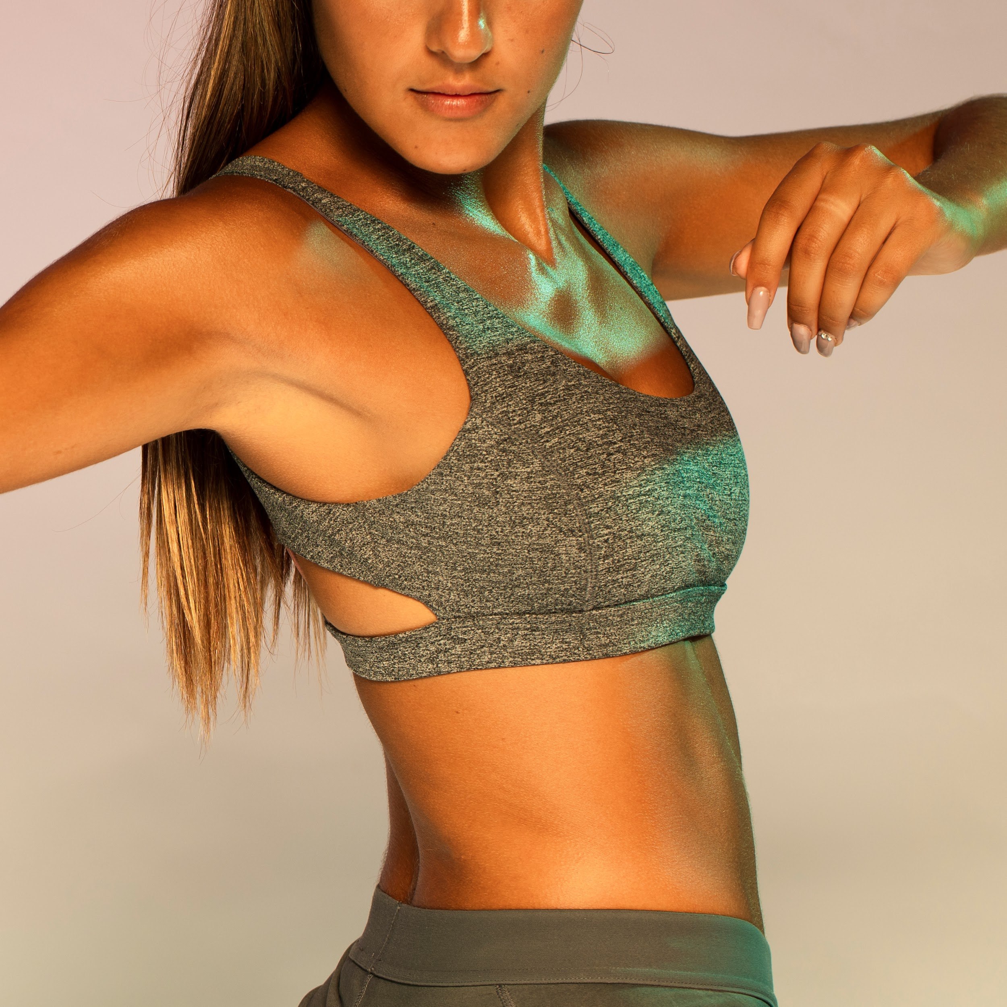
PROBLEM STATEMENT
People prefer SHORT yet effective workout sessions.
And for that, the most important thing is FORM.

Slide 4
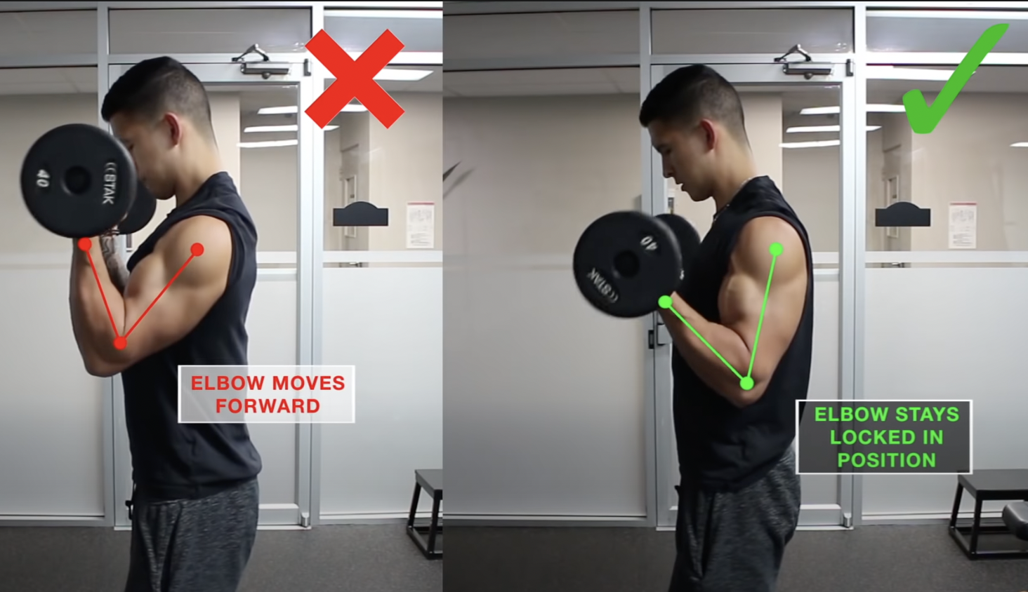
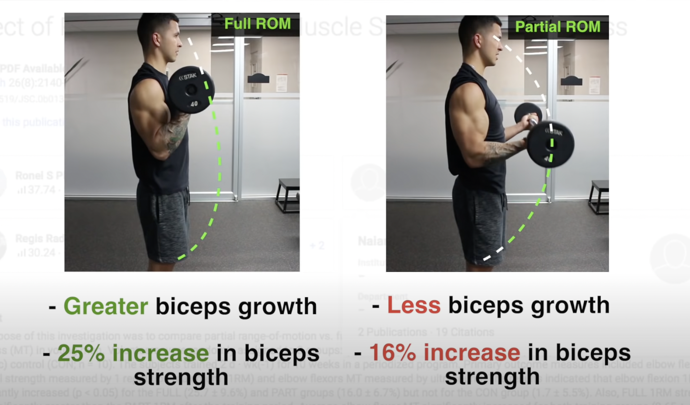
PROBLEM STATEMENT
For Example, let us take a simple workout of Bicep Curls.
We can see that with the right form and with the correct range of motion, there is a 25% increase in biceps strength with the same number of repetitions.
Hence, Right form = More Gains
Correct form, posture, rep count, breathing and contracting are the keys to making any workouts effective.
BUT HOW TO TRACK IT ??

Slide 5
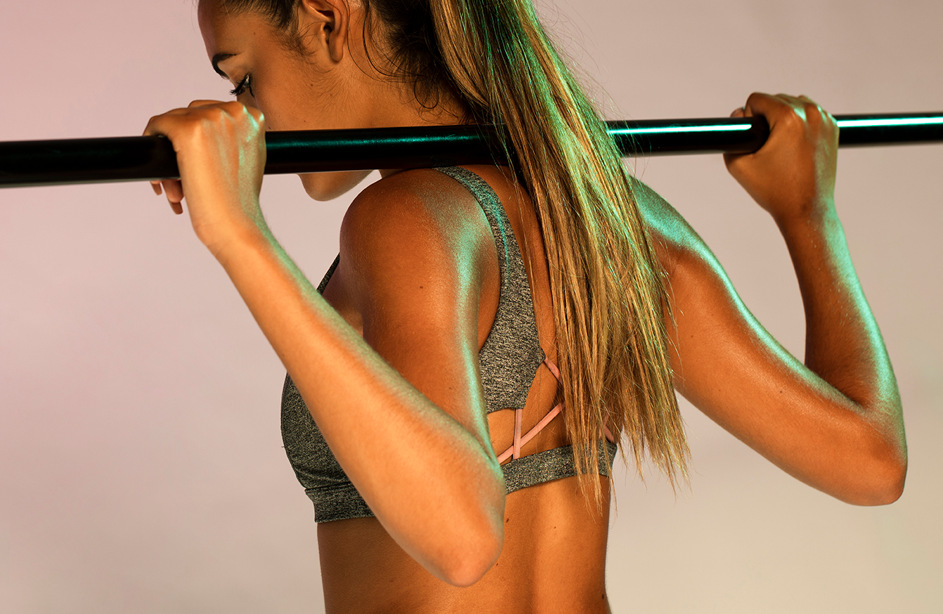
SOLUTION?
FITIFY

Slide 6
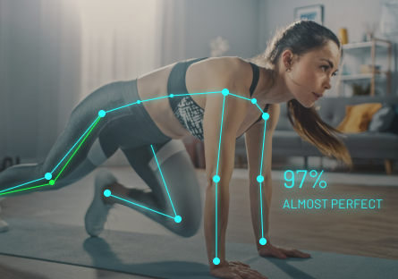
BUSINESS CONCEPT
Fitify is a voice/gesture-based fitness tracking app, which uses computer vision to correct your posture, count reps, guide breathing, and much more.
Basically, a personal trainer installed right into your devices !
Will be with you throughout your workout to guide you at every step so you get the most even if you do a small workout.

Slide 7
DEVICES
PLACEMENT
COMPUTER VISION
HOW IT WORKS ?
MACHINE LEARNING
VOICE/GESTURE
TRAINER MODE
You can install it as a mobile or a web application
Place your phone or laptop as instructed by app before workout
Set and start workout while FITIFY corrects your posture, counts reps, etc. in real time
Get detailed analysis of what mistakes you have been doing and how well you have corrected them
Use your voice or hand gestures to navigate through app, start/stop workout, reset reps, etc., so that your full concentration is on workout
In this mode, you can enrol as a trainee, upload right workout structure and earn.

Slide 8
SO FAR
Quick summary before we move on to the subscription plans
Our fitness startup offers an app that uses openCV technology to analyze and correct users' posture while exercising.
With real-time feedback and personalized recommendations, our app helps users avoid injury and maximize the effectiveness of their workouts.
Our user-friendly interface and customizable features make it easy for people of all fitness levels to use and achieve their goals.
Join our community of fitness enthusiasts and take your workout to the next level!

Slide 9


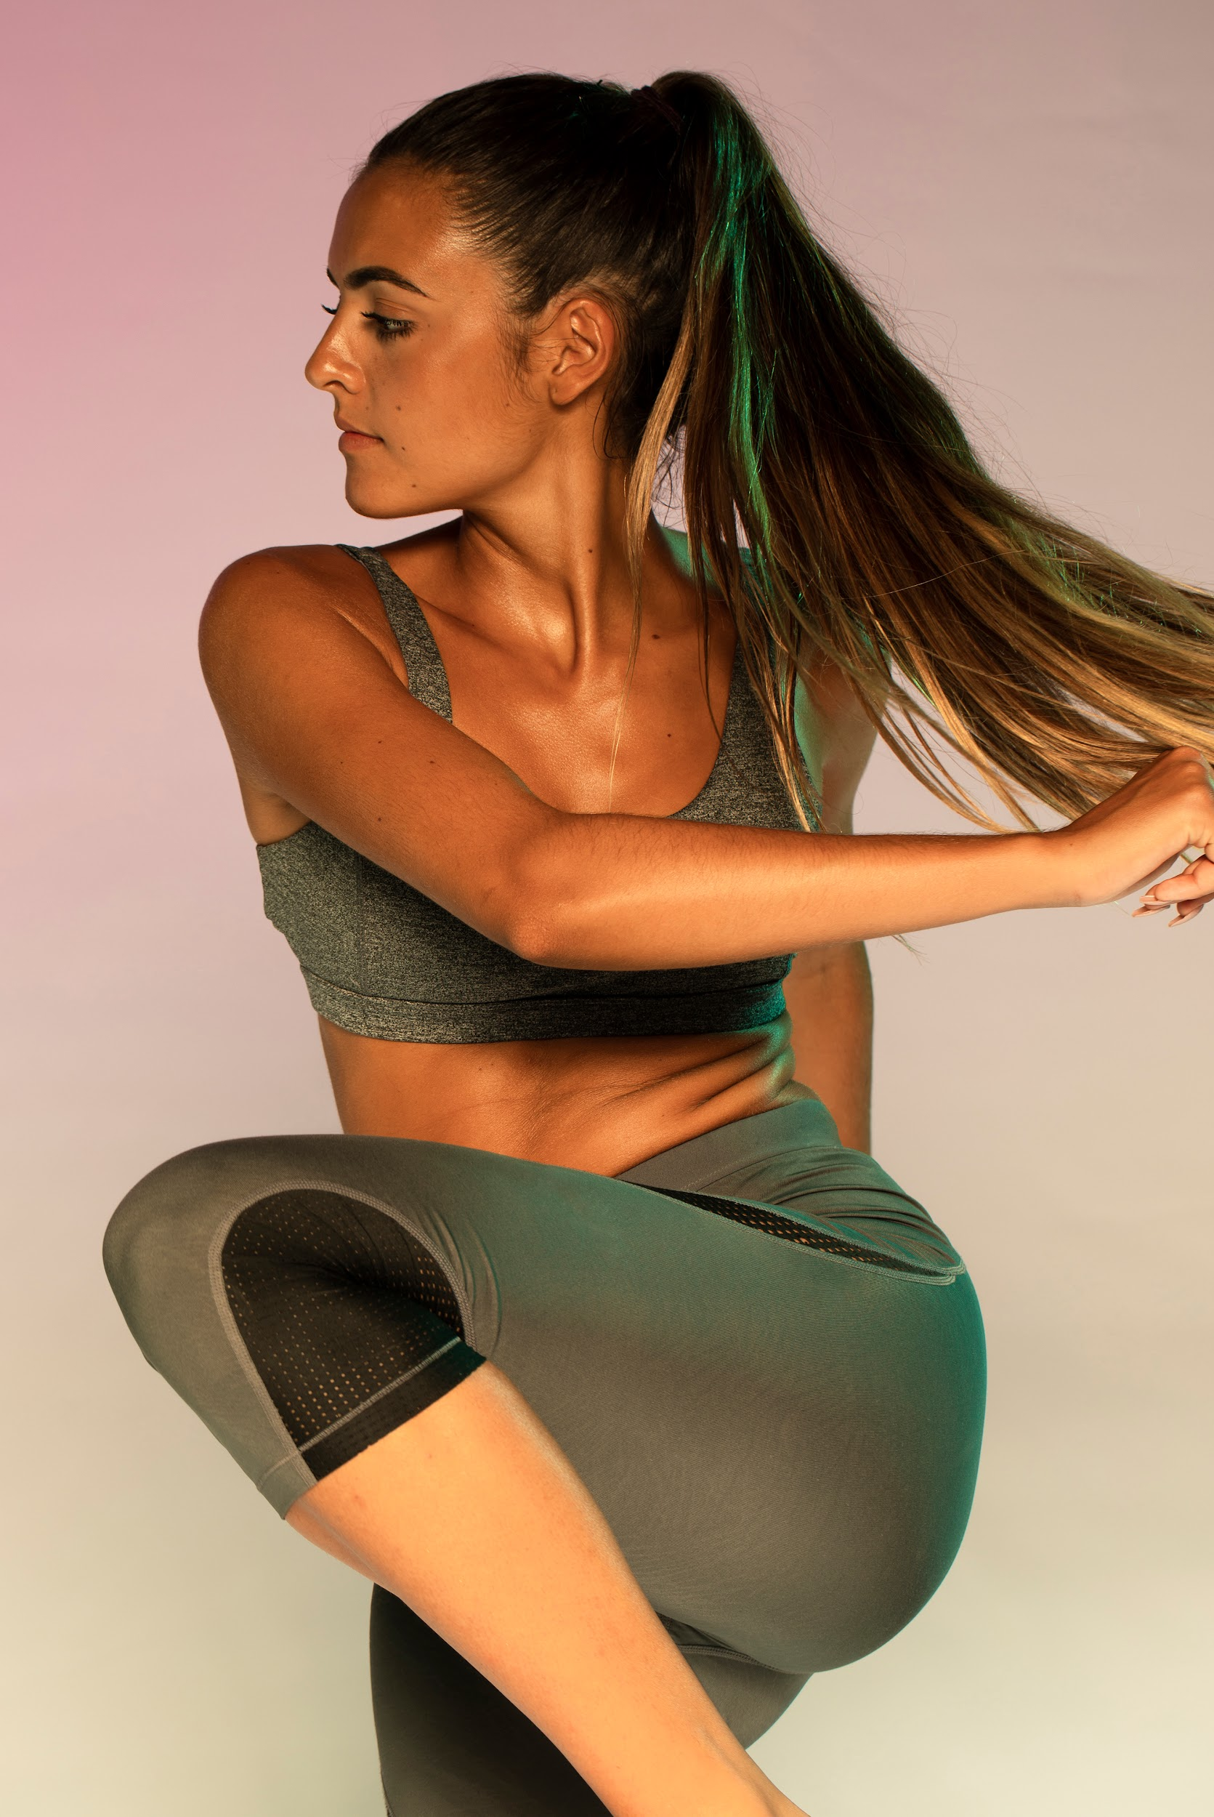
OUR PLANS
FREE
PRO
PREMIUM
Voice feedback
Rep-count, customisation, etc.
Compare with yourself
Posture correction
Compare with Friends
Improvement tips
Diet plans
Voice navigation
Body measurements

Slide 10

SUBSCRIBE
MAKE THE MOST
IF TRAINER, GET PAID
OUR COMPANY
Download and Subscribe to our app
Take the full advantage, get fit, faster, at the comfort of your home
Upload any workouts correct form and earn

Slide 11

TARGET CUSTOMERS
Middle and upper classes with busy schedules.
People who want to workout from the comfort of their homes.
Those who go to gym but prefer working out by themselves.
GENDER
Female
Male
AGE
25-40
40-65

Slide 12
VALUE PROPOSITION
Posture control
WHAT
Trainer/Trainee Mode
Improvement and mistake correction
HOW
WHY
Voice/Gesture navigation

Slide 13

OTHER BUSINESSES
 | COMPUTER VISION | TRAINER / TRAINEE MODE | VOICE ENABLED | MISTAKE ANALYSIS
Vay Sports | Yes | - | - | -
Onyx | Yes | - | Yes | -
Tempo | Yes | Yes | - | -
FITIFY
Yes
Yes
Yes
Yes

Slide 14
$ 21.82 billion
REVENUE MODEL
The global online/virtual fitness market size grew from $15.65 billion in 2022 to $21.82 billion in 2023 at a compound annual growth rate of 39.4%. It is expected to grow to $76.57 billion by 2027 at a CAGR of 36.9%.

Slide 15
The free version will generate revenue only through ads.
The other two plans are paid versions.
Incentives and pay to trainers based on the number of people subscribed to their uploaded workout.
Paid dieticians for a customised diet plan.
REVENUE MODEL

Slide 16
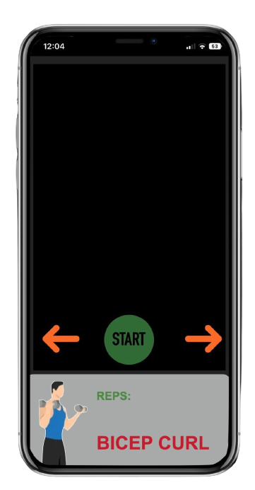
App Demo

Slide 17
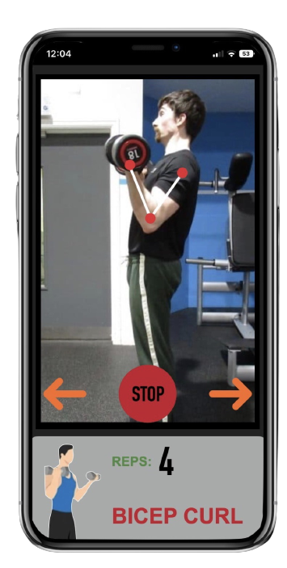
App Demo

Slide 18
New Feature
We also have a novel body measurement feature. Patent Pending!

Slide 19
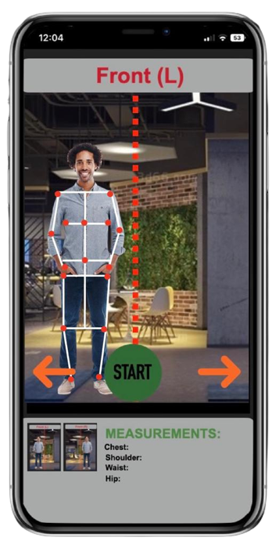
Body Measurement

Slide 20
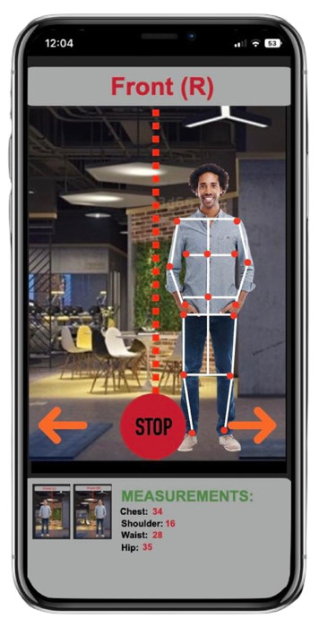
Body Measurement

Slide 21
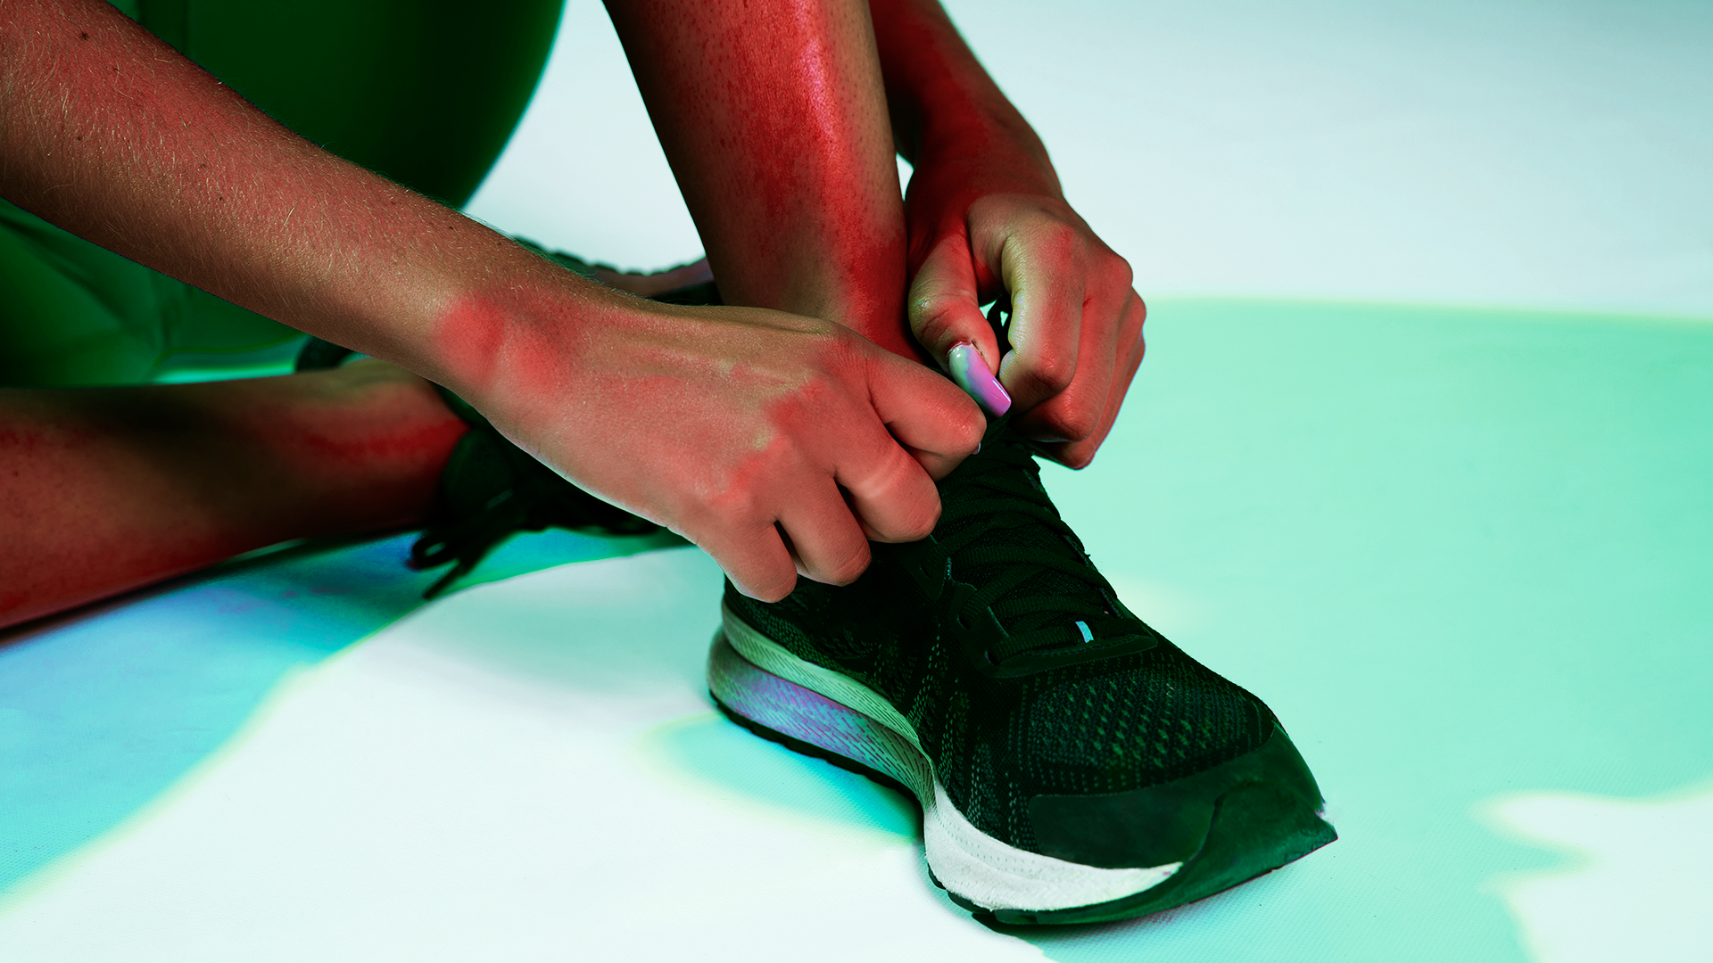
VISION
We have an ambitious future planned for our company.

Slide 22
TEAM
MEET THE TEAM

Slide 23
RESOURCES
Facts from below links
https://www.researchgate.net/publicat…
The Online/Virtual Fitness Market Is Expected To Reach $79https://www.globenewswire.com › 2022/03/22 › The-O…
Covid Outbreak Throttles India s Fitness Industry - BW ...https://www.businessworld.in › article › Covid-Outbreak-...
https://startuptalky.com/healthifyme/

Slide 24
Key takeaways from Research
40% of fitness clubs have tapped into the hybrid models
56.1% of surveyees workout at home post Covid-19 outbreak
Walking (78%) and Running (46.3%) are the most followed fitness activities.
43.9% supplement their workouts with meditation and 31.7% with strength training
43.9% of respondents bought suitable fitness equipment for exercising at home after the pandemic
53.7% of fitness enthusiasts use a wearable device to monitor their fitness activity
65.9% state that they have appended their fitness regime post Covid-19 outbreak.
17.1% of surveyees have opted for virtual fitness subscription services or on-demand fitness content
41.5 % of respondents reported that they prefer group workouts
85% of surveyees assert the importance of emotional, mental, and spiritual health to promote overall physical wellness and quality of life.
There is a demand for certified fitness professionals
Short workouts encompassing high-intensity exercises are trending

Slide 25

THANKS!
Any questions?
REVENUE MODEL
Glad to Answer

